Slide 1


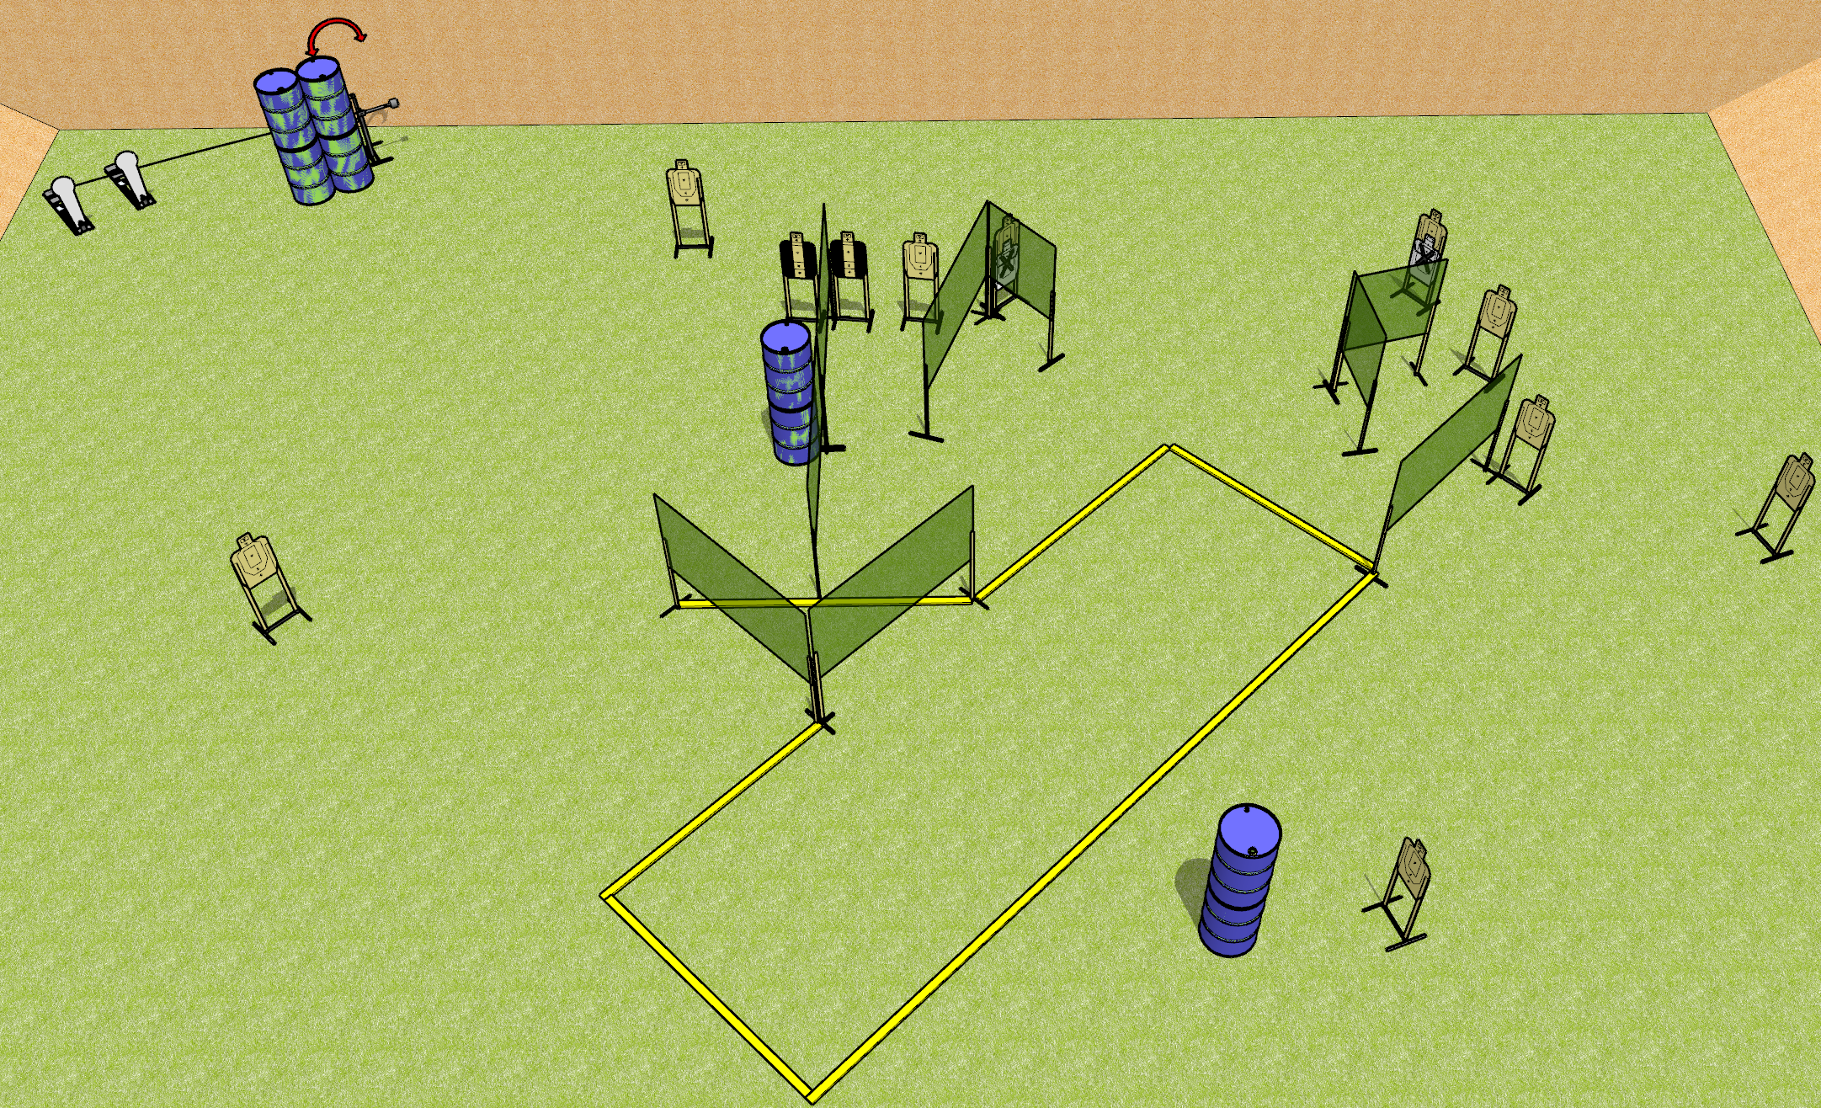
 | Dothan Gun Club – USPSA Match Footwork Course Designer : Drew Coleman
START POSITION : Anywhere inside the shooting area, wrists below belt
GUN READY CONDITION : Pistol loaded and holstered. PCC loaded, held with both hands, shouldered, safety on, pointed at orange cone. |  | SCORING: Comstock, 26 rounds TARGETS: 12 paper, 2 Steel SCORED HITS: Best 2 on paper, steel until down START-STOP: Audible, last shot RULES:
STAGE PROCEDURE: Engage targets as they become available from within the fault lines.

Slide 2
Footwork
Written Stage Briefing
Footwork is a 26 round, 130 point, Comstock field course. There are twelve USPSA targets and two colt poppers. The best two hits on paper will score, and steel must fall to score. The start signal is audible.
The swinger is activated by either colt popper. Please check the activator prior to walkthrough and set it the same way every time.
Handgun start position is anywhere inside the shooting area, wrists below belt. Handgun is loaded and holstered.
PCC start position is anywhere inside the shooting area. Loaded carbine is held with both hands, stock on belt, safety on.
On start signal, engage targets as they become available from within the shooting area.

